Slide 1
Why Didn’t My
Awesome App Win?

Slide 2
Amelia Earhart Memorial Scholarship Fund

Slide 3
About the AEMSF
Established in 1940 to help deserving Ninety-Nines advance in their training and education in aviation
First scholarship of $125 awarded in 1941
Today, the Fund exceeds $5 million
$11,000,000+ in scholarships has been awarded
746 AEMSF scholarships given
215 Fly Now (formerly New Pilot) awards since inception

Slide 4
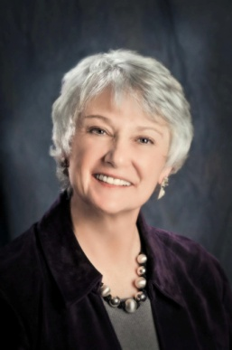
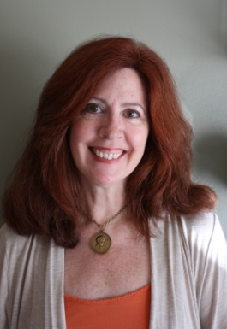
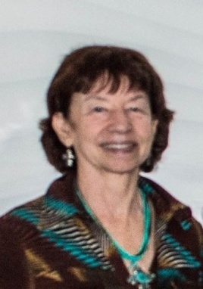
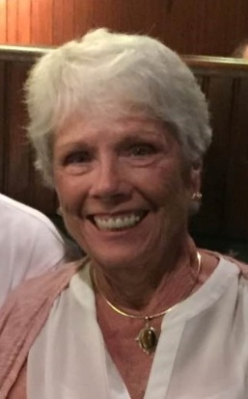
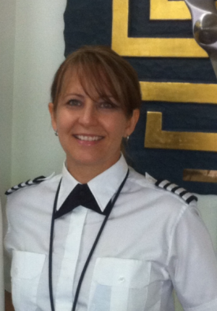
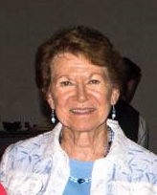
Your AEMSF Trustees
Dr. Jacqueline Boyd AEMSF Chairwoman
Permanent Trustee Research Scholar Grant Chairman
Rio Grande Norte Chapter
Shelley Ventura Vice-Chairman Trustee 2016-2019 Aux Plaines Chapter
Dorothy Berthelet Permanent Trustee Treasurer Eastern Ontario Chapter
Peggy Doyle Permanent Trustee Old Dominion Chapter
Linda Mathias 2018-2021 Trustee Hampton Roads Chapter
Dorothy Norkus Secretary Trustee 2017-2020 San Diego Chapter

Slide 5
Annual Scholarship Ceiling
Our yearly budget is determined by taking 5% of the averaged year end balances of the AEMSF investment fund over the previous three years.
Any unused funds from forfeitures are added
The Fund is large but the budget is not unlimited!
Thus, only the strongest AEMSF apps are funded
The remaining money is then divided in half for the Spring & Fall Fly Now awards

Slide 6
An AEMSF award is an investment in a Ninety-Nine

Slide 7
The 2018 Awards Budget
AE Scholarships - $142,105
Spring Fly Now - $71,500
Fall Fly Now - $71,500

Slide 8
Trustee Grading Process
To be selected, the application must be better than good, it must be excellent!
Those who score at the cutoff range are discussed may be reevaluated taking into account other Trustee insights
Applicant final scores might be adjusted up (or down) depending on that discussion
Trustees evaluate the applications and send top tier applications and the alternates to outside the judges

Slide 9
Make it Perfect
You don’t get a second chance
to make a first impression!

Slide 10
Key Grading Points
The highest scoring applications
Are complete and on time
Are neatly presented and typed
Have very clear, well organized and properly oriented document and image attachments
Have a well written, grammatically correct and overly detailed essay that communicates the Key Essay Topics. (ESL is considered.)

Slide 11
Present Your Best Possible App!
Type it
Attention to detail is paramount
Text should fit on the lines (not under or off the end)
Do not hand write on the margins. It makes it seem like you cannot be bothered to put in an effort.
Fill in all applicable lines or boxes
Grid forms should be accurate and readable
Crisp, clear docs, straight and attachments

Slide 12
The Polished Application
Only submit the required documents
Do not submit extras to ‘bolster’ your app
This includes resumes, articles, photographs, QR codes or other items not requested in the application
Doing so increases the workload in processing your application for the judges
If you make a mistake fix it/start over (never cross out)
Follow the directions!

Slide 13
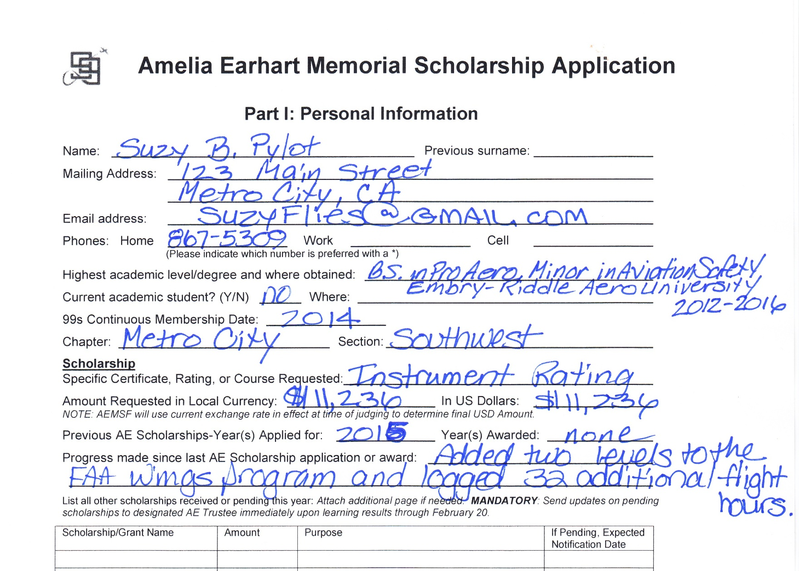
What kind of first impression does this give?

Slide 14
Formatting issues
Text should fit on one line and not go or under the line or past the end.

Slide 15
The Polished Application
A neat and complete flight grid -

Slide 16
Typed but…needs work
Flight times should match the hours in your logbook. They are not estimates. The pay off of being selected a winner is worth many thousands of dollars per hour
That it took to compete your application. Put forth the effort.

Slide 17
The Polished Application
A very neat, easy to read and complete cost basis grid:

Slide 18
Not so polished…
Hard to read, info in wrong columns and incomplete cost basis grid. Poorly done flight school paperwork reflects on YOU, not them!

Slide 19
Time for a redo…
All copies should always be clear and legible. Color images are preferred.
Apps are read electronically, so image orientation should be appropriate.

Slide 20
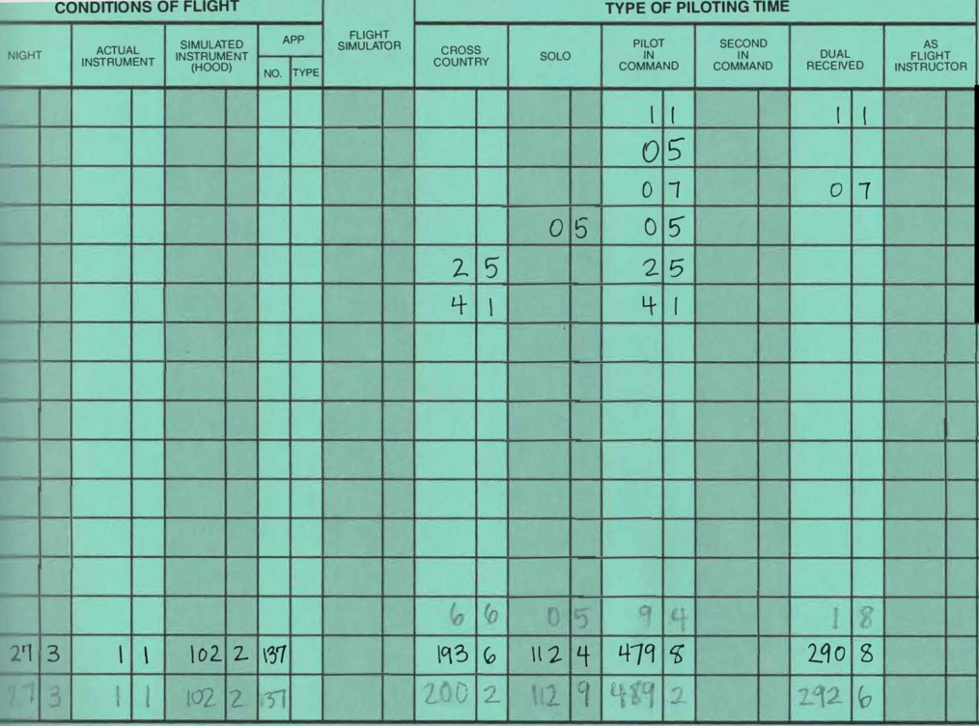
Logbooks
All columns should be totaled and amounts forwarded.
Use pencil if necessary.
One log page = left and right sides.

Slide 21
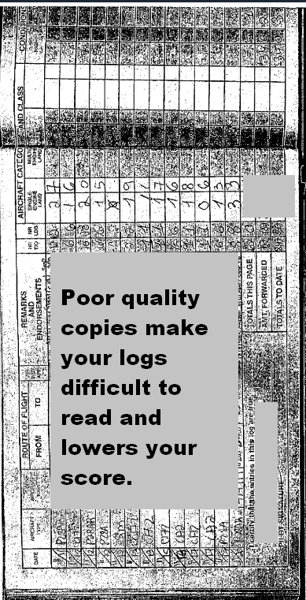
Logbooks
Follow the instructions explicitly on Part VI
The year should be noted on each page.
Pages should not be oriented vertically
Clear scans or smartphone images are superior to poor Xerox copies

Slide 22
The Essay -

Slide 23
Key Essay Topics
Don’t omit this critical info as your score will be affected!
Immediate and future goals are clearly stated
A realistic plan to achieve that goal is laid out
A case for financial need is presented
A budget including income & funding options is presented
The steps you’ve taken towards the goal so far
Challenges and setbacks you’ve faced
Your Ninety-Nines participation
How you different from any other applicant

Slide 24
Creative Writing
An outstanding essay can make up for points lost in other less impressive areas of an application.
Brush up on essays and their format online
Think of your ‘hook’ – and how to sell yourself
Write to bring the reader in, build empathy
Eliminate redundant info found elsewhere in the app
Avoid, “I am, I will, I have, I, I, I….”
“Hello” or “Dear” are better suited to an email

Slide 25
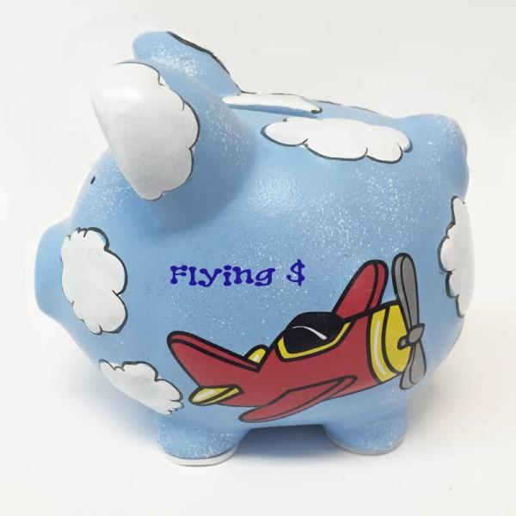
What is Financial Need?
“Financial Need” is not simply based on a low or no income
Your need is substantiated in your essay
Factors that affect an individuals ‘need’
Areas with few affordable training options
Areas with a high cost of living
Student loan debt
Medical debt

Slide 26
Explain your financial need
How is your income budgeted?
How much have you already saved for your goal?
How will you fund your training besides a scholarship?
Loans, extra job, savings, getting a roommate ect.
Income, expenses and training budget should be addressed in your essay. This is not enough-

Slide 27
Address red flags
A history of stopping and starting again?
Do you have a lot of hours and little progress?
Few hours and little progress over a long period?
You have almost 70 hours and haven't soloed, why not?
Address it! Don't leave the judges wondering about your situation, tackle it head on.
How you are handling that adversity and what you learn from it can pump up your application

Slide 28
Letters of Recomendation

Slide 29
Personal LORs
Not written by family or your spouse
A person who can attest to your
Moral character
Work ethic and drive
LORs should be specific to the award, dated & signed
Aviation Recommendations should address
Your specific skills and aptitude
Performance in aviation
From someone who has flown with you

Slide 30
Chapter LORs
Each point required in Part VII must be addressed
LORs lacking these details make it seem the writer does not know the applicant very
Judges look to this LOR for details not in the essay.
Do not simply repeat what the applicant stated in their essay! Expand upon it and give your own insight.
Weak chapter LORs may impact an applicants score.

Slide 31
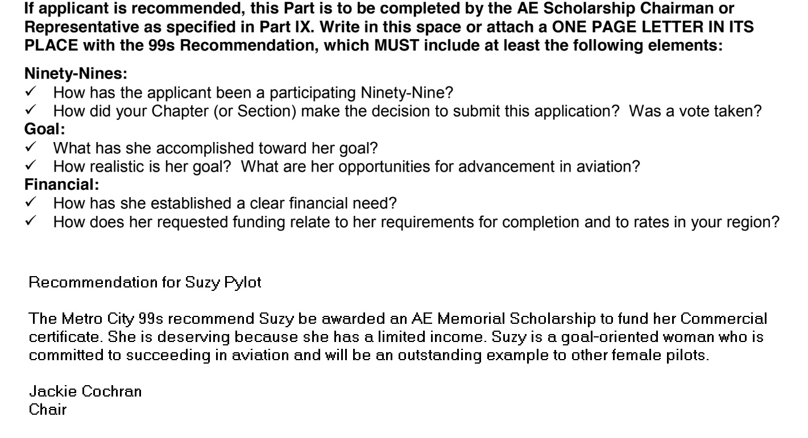
Poor Chapter LOR
Unfortunately, examples like this are still submitted:

Slide 32
Check and Double Check it!
Examine all parts for accuracy
Verify all sections are complete
Have a friend with a critical eye help
Use a program like GRAMMARLY
Check attachments for readability
Be sure all required signatures are there
….and finally submit on time!

