Slide 1
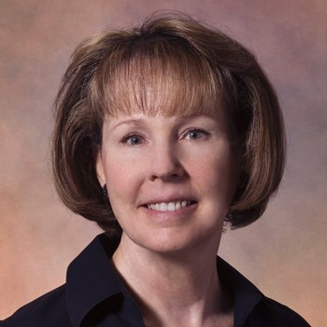
Your Host – Jan McKenzie
Colorado Chapter
South Central Section
Member since 1974
Current 99s Vice President
Flies a Mooney 252

Slide 2
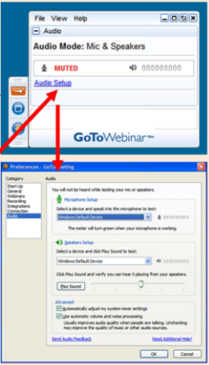
Trouble with the Audio?
If you are not receiving the audio, check the control panel. If it is not visible, click on the arrow to reveal it.
Click on “Audio Setup” to bring up the audio screen.

Slide 3
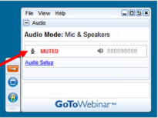
We Can’t Hear You
Everyone is muted.

Slide 4
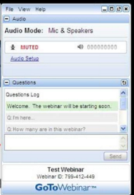
Got a Question?
Questions can be written and submitted from the bottom of your control panel.
Click in the box, type your question, and hit Send.

Slide 5
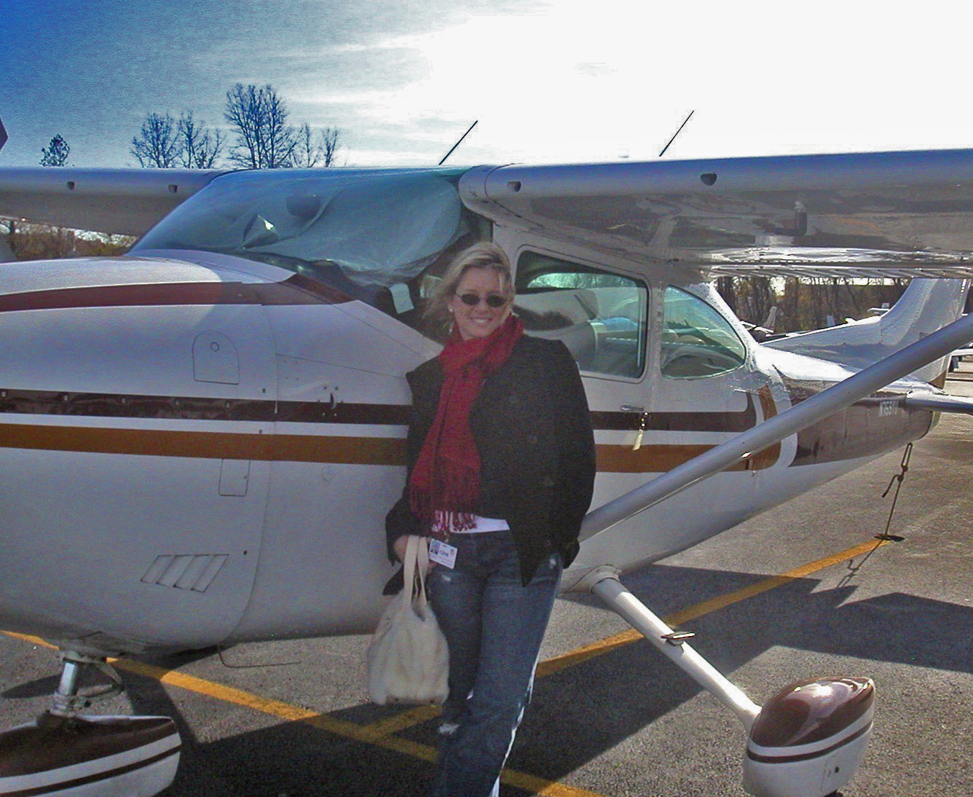
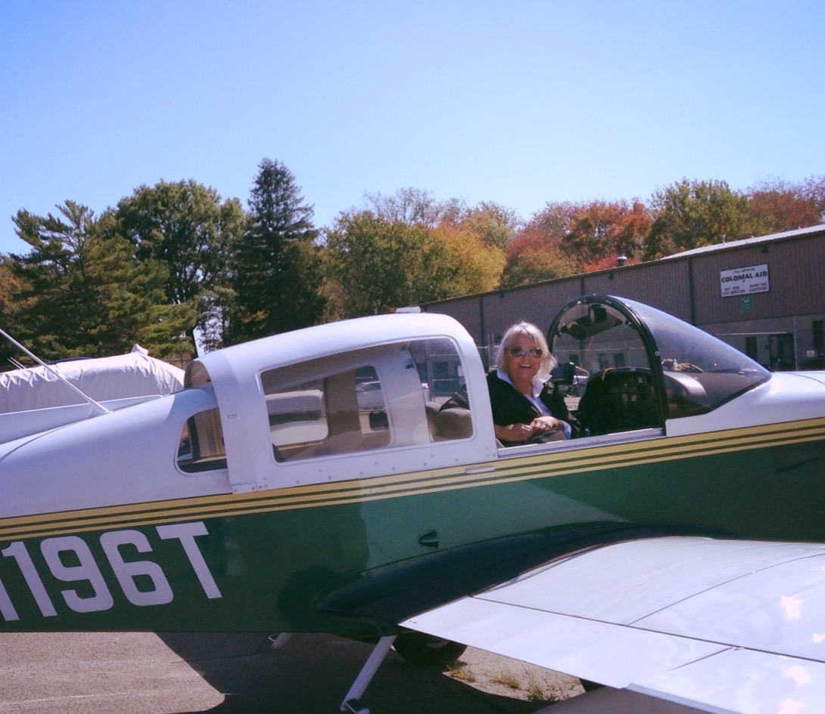
Your Presenters – from the North Jersey 99s
Shannon Osborne, Chapter Chair
NY NJ Section Director
Member since 2004
Flies a C-182
Susan Cafoncelli, North Jersey Chapter
Member since 2010
‘92 Grumman Tiger

Slide 6
Weaving Your Web How to Build a Website to Support Chapter Growth

Slide 7
Getting Started
Who are you?
What is your purpose?
Define your presence
Build your Site

Slide 8
Who are you?
www.NJ99.org
Your domain is your internet address
You can pay for the domain and choose your address or obtain an address that is free but with some limitations such as including the free host’s name in your web address
Registering a domain $10-$15/year
Packages may include the domain name
Importing domain $50-$150 annually

Slide 9
Free domains
Pros
Cons
Free
Good for small group that is mostly inactive
Often have easy to set up web site tools in a package
Domain is temporary
Names are limited
Names are complicated
Awkward to look at & copy
(business card or stationery)
Businesses change
You can’t take the name with you if your host goes out of business or starts charging
Would need to totally rebuild on a new site
Dead links from linking orgs

Slide 10
What do these names reveal about the organizations?
http://nynj99s.wix.com/ny-nj-99s
http://antelopevalley99s.wix.com/av99s
http://tlbubb.wix.com/gorgeairrace#!the-99s-have-a-history-in-air-racing/zoom/mainPage/image_2268
(These sites were generated on Wix.com)

Slide 11
Paid Domain
Pros
Cons
Permanent address
Simple, memorable
Looks good on a business card or presentation
Can be moved to another host without rebuilding or losing links
Can be pricey

Slide 12
What’s in a name?
What do these names tell you about the organization?
http://www.ninety-nines.org/
http://www.nj99.org/
http://www.mid-atlantic99s.org/
http://www.santaclaravalley99s.org/
http://www.ak99s.org/
http://www.mountshasta99s.org/
http://www.neworleans99s.org/

Slide 13
What is your purpose?
Archive your activities
A place to interact with members
Communicate activities and you have a lot of them
Attract new members
Attract benefactors
Promote aviation in your community

Slide 14
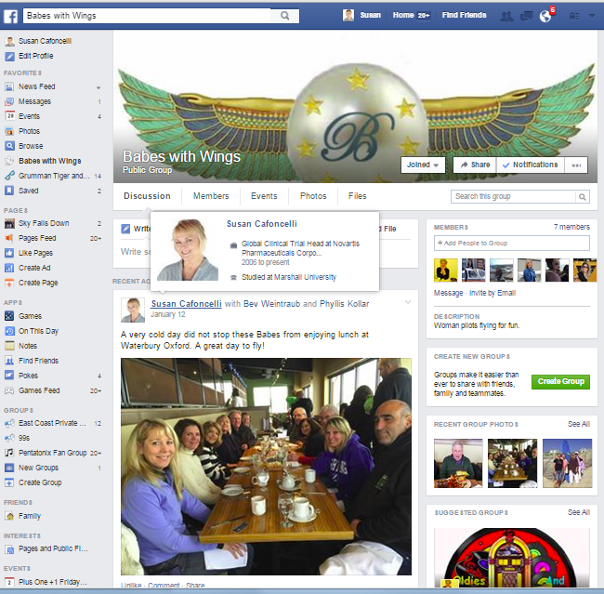
If you want an active archive of chapter activities consider
Social Media
Pages are free

Slide 15
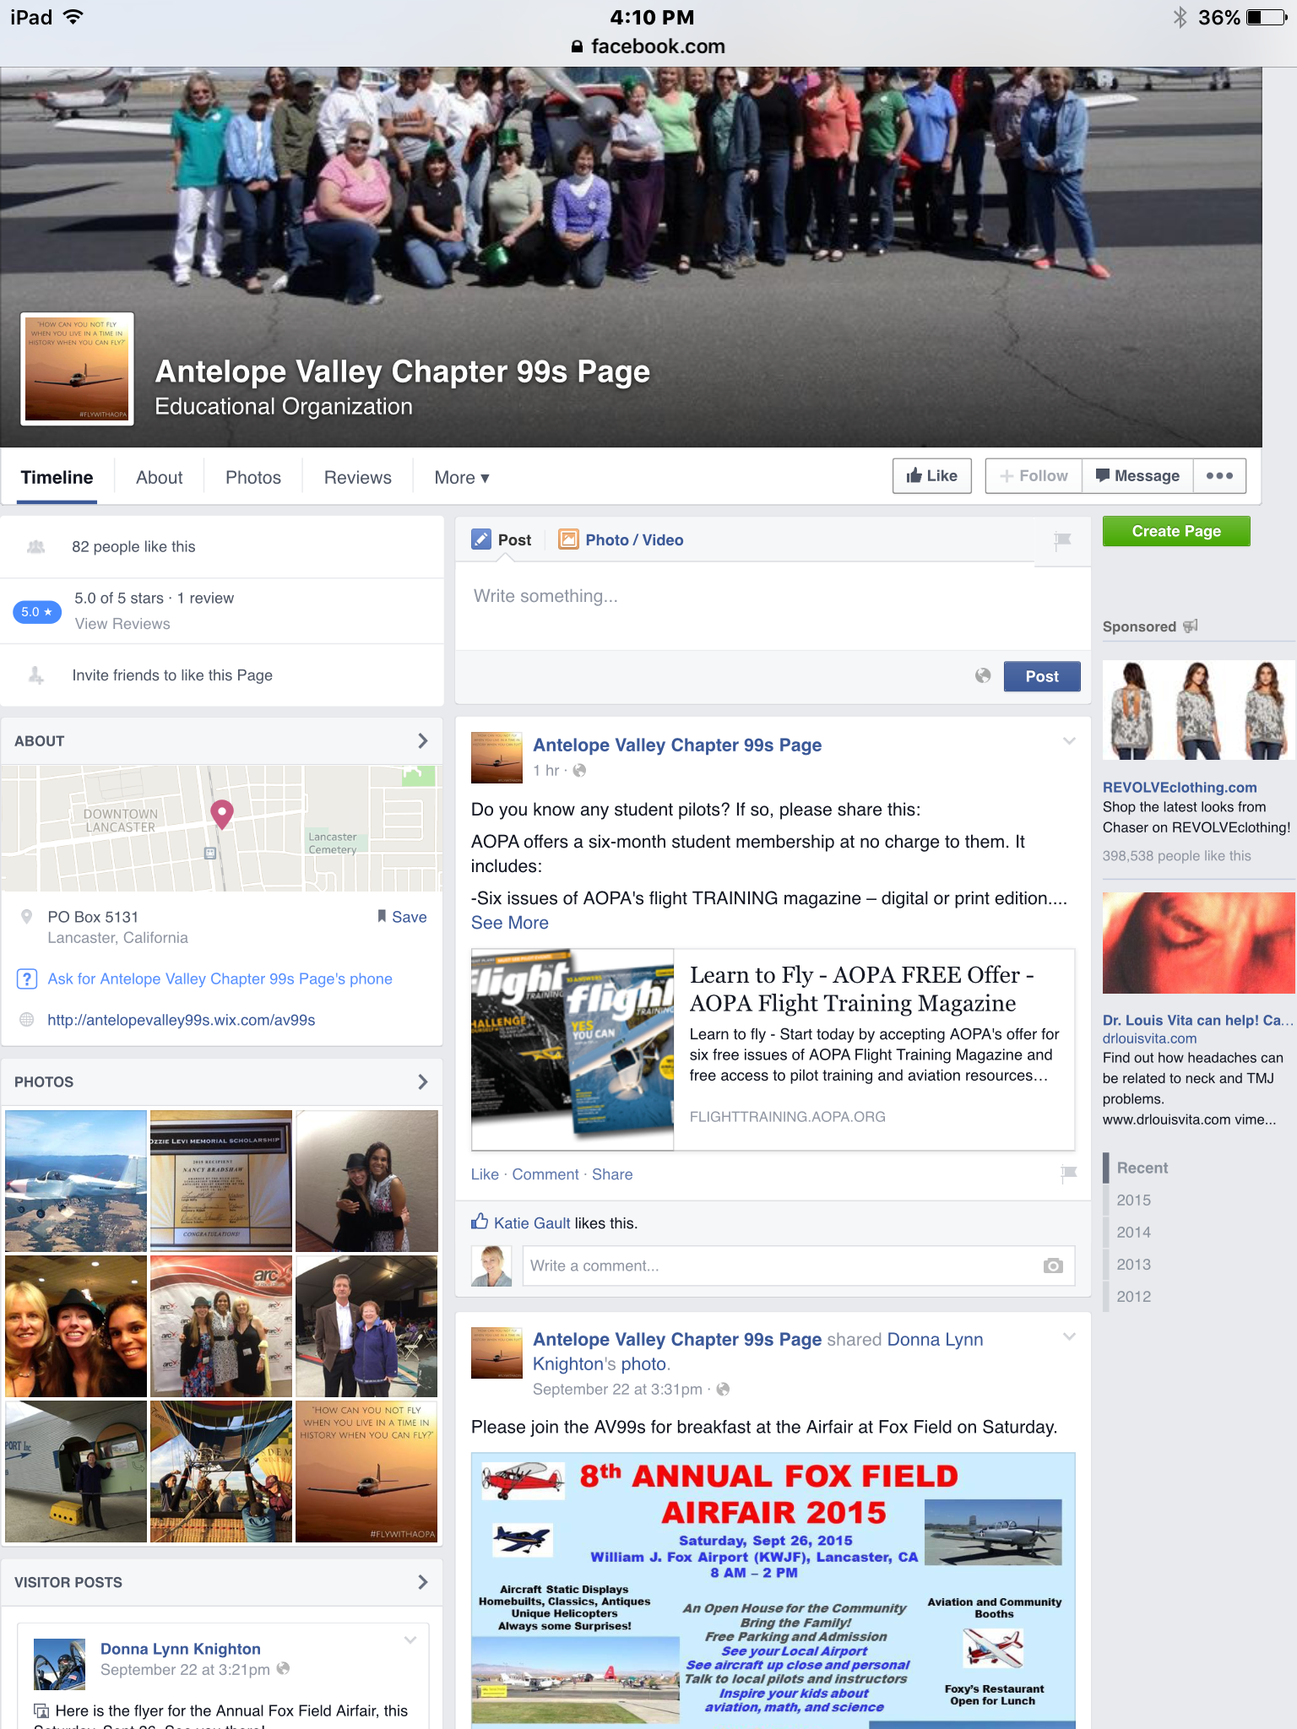
Facebook provides plenty of opportunities to interact with members
Discussions
Events
Photos
Files

Slide 16
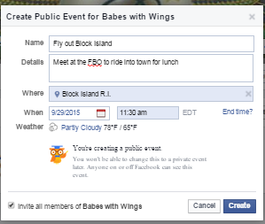
Let others know what you are doing
Has some organizing functions such as event invitations
Open or closed group
Must keep it up to date
Control posts
Post at least monthly

Slide 17
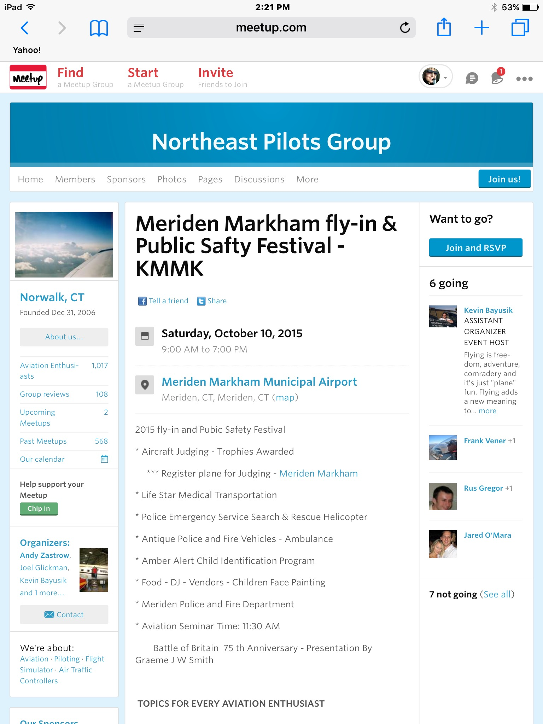
Do you need to communicate activities?

Slide 18
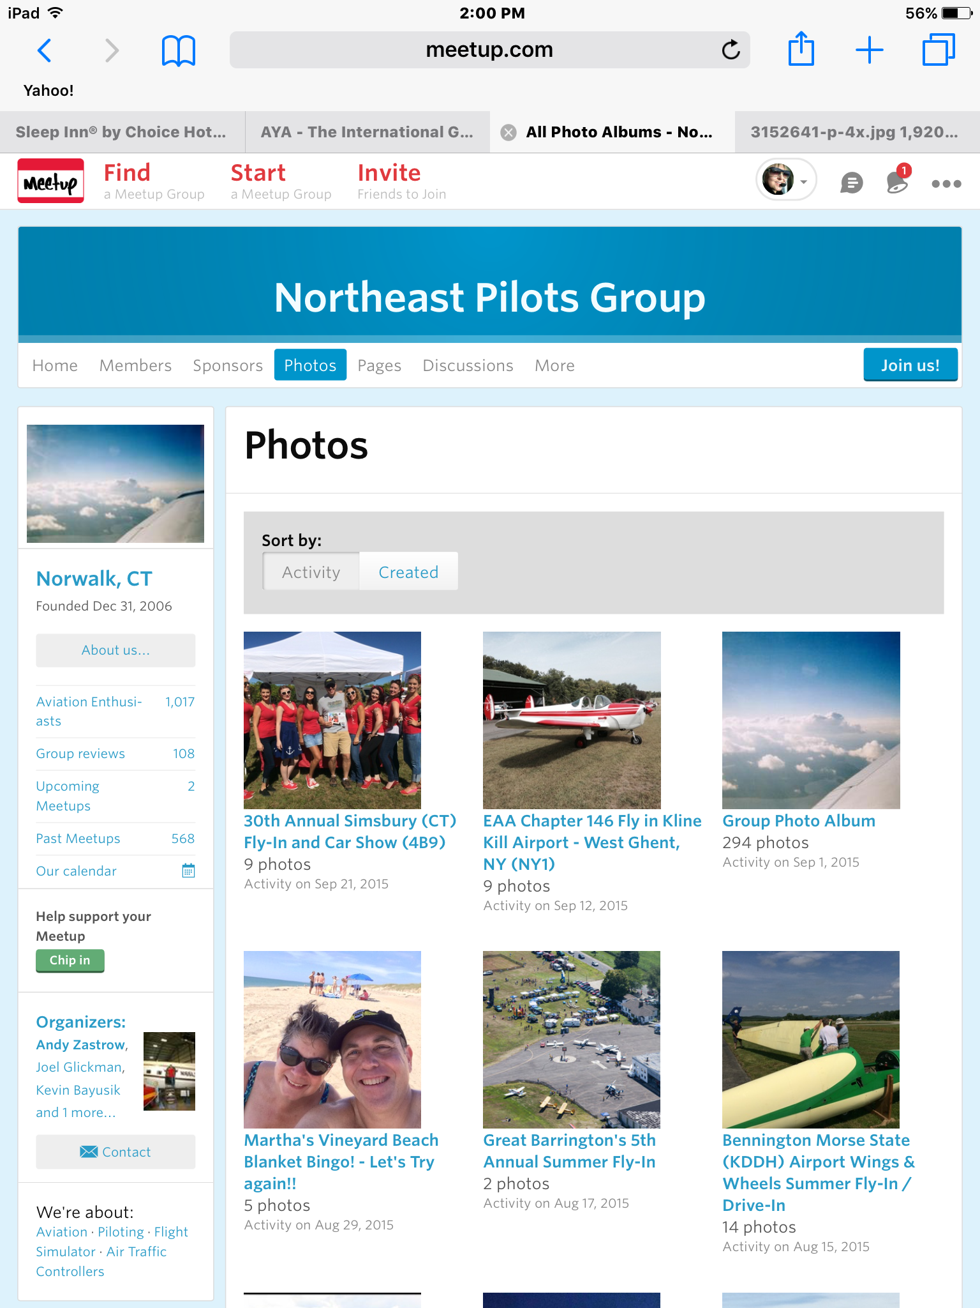
Meet-up is great to communicate events
and fly-outs to members
Around $150/year
Set up events and archive the results easily
Management of member privacy
Choice of mailings and emails to receive
Easy group communications
Maintains your emails lists
Flexibility and control of postings
Can link to your website
Attracts members!

Slide 19
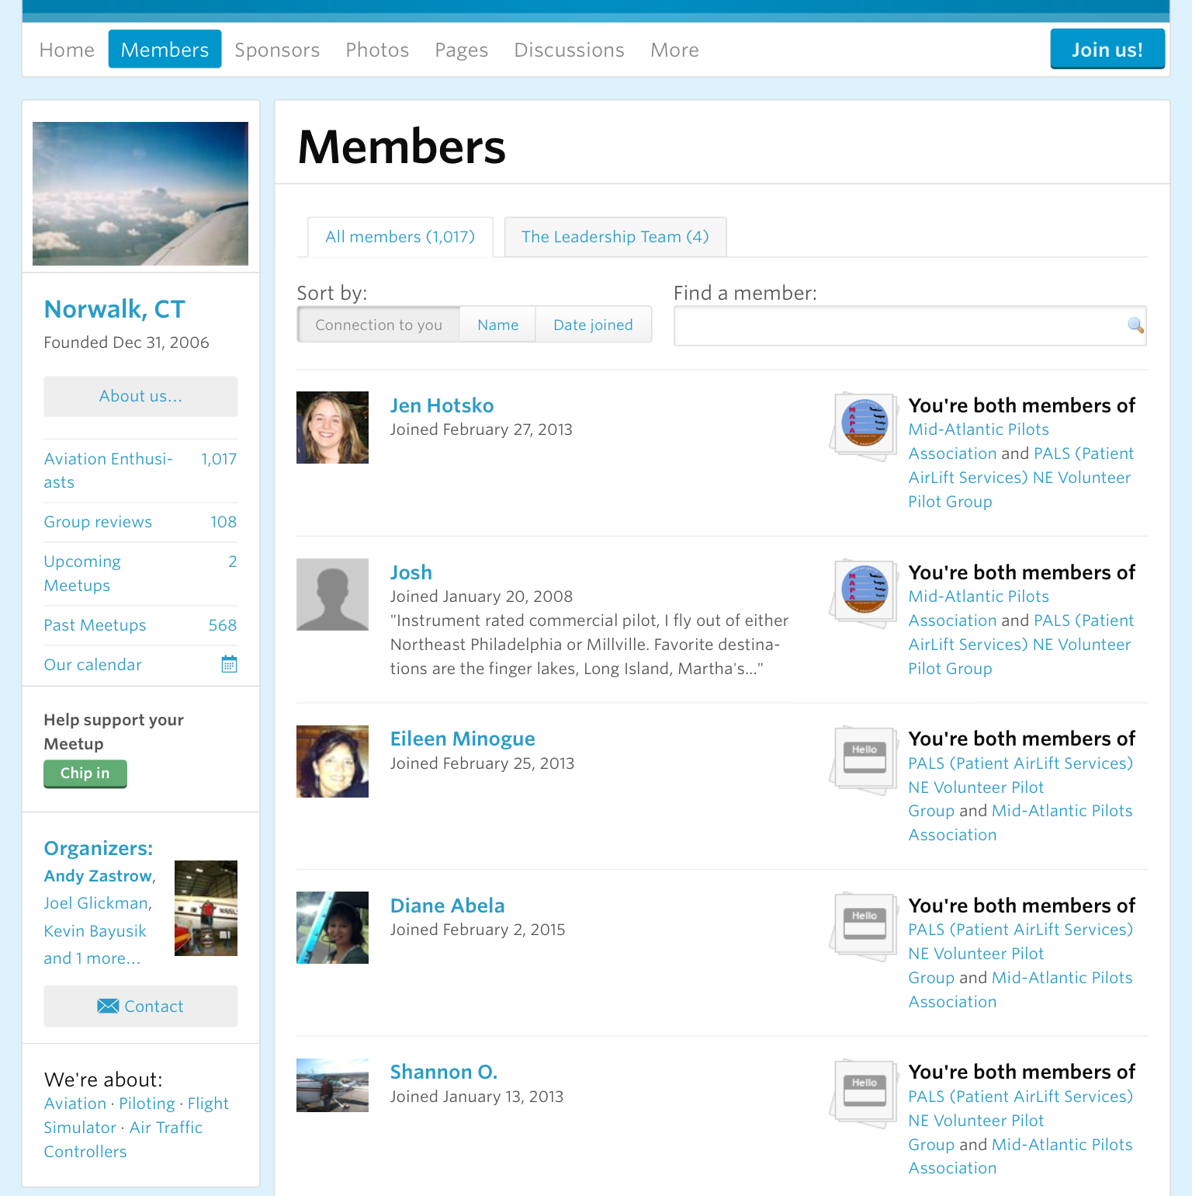
Meet-up membership profiles
Helps networking
Can’t remember who?
Focus profiles by asking for specific information such as ratings, what you fly
Attracts new members

Slide 20
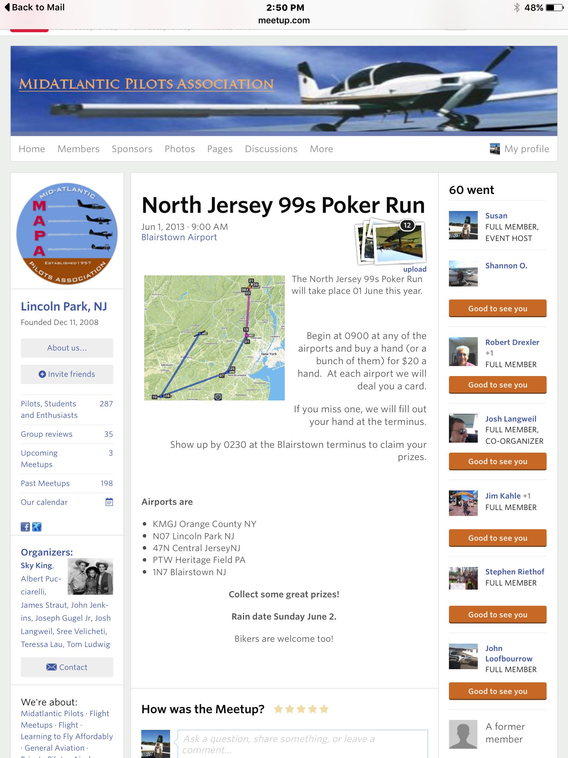
Meet-up networks with chapter flyouts and events
Weave a Web:
Link 3-4 regions to share flyouts, events and share the cost!

Slide 21
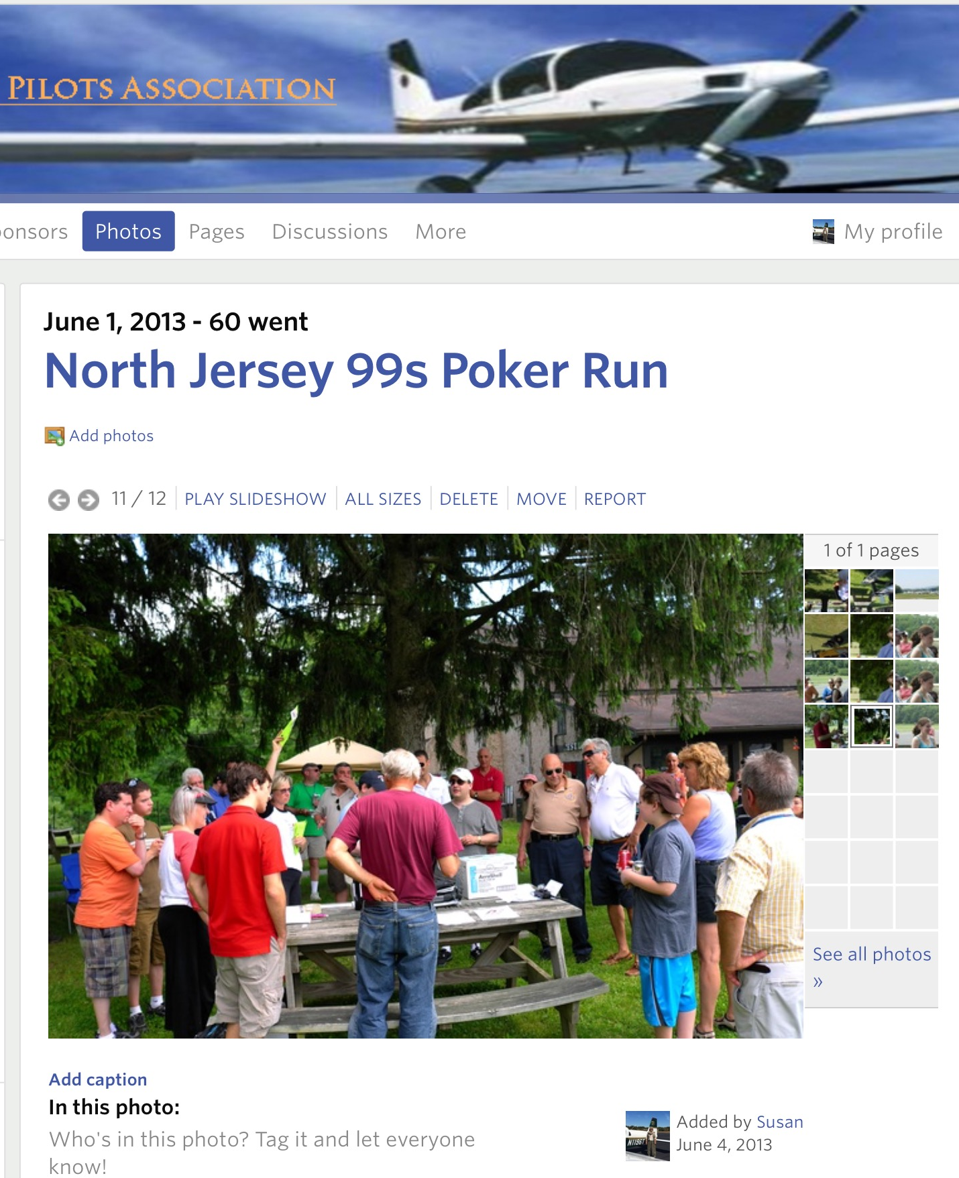
Meet up packages events
Invitations
Reservations
Report of the events with photos

Slide 22
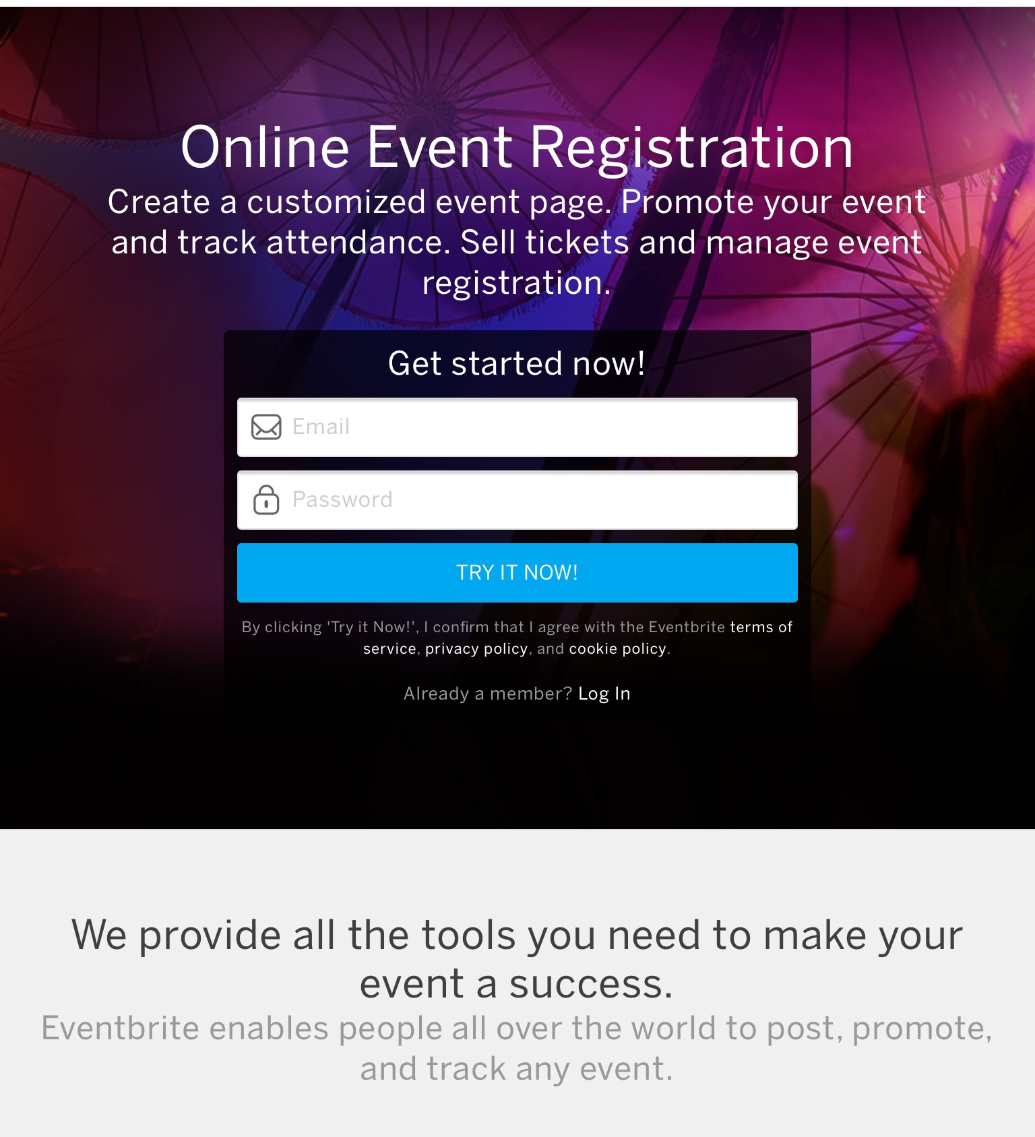
Everbrite

Slide 23
You still want a web site Who will host your website?
Blue host using Word Press

Slide 24
Tips for a Great Website
Keep It Simple Stupid!
Less is more - limit your site to 5-6 pages
Include ONLY chapter information ( photos and stories)
Link to other organizations within your site
Link only to sites who will link back to you
Try a leading page for upcoming events
Your event comes up as the home page
Your usual home page is linked to the event page

Slide 25
Tips for Using Photos
Photos should be of close up well-lighted smiling faces
avoid dead people even if they were interesting
avoid photos of massive numbers posing people unless action shots
Be sure to download International’s
Guidance document
Ask permission if you can post it
Avoid food and alcohol photos
Include flying and planes whenever possible

Slide 26
Keep it Short, Sweet, and Simple
55% of Visitors spend less than 15 seconds on your website.
Determine what you want them to know concisely
Make these the title of your pages

Slide 27
Outline your pages
Home:
How are we distinctive: Service 60 Women Pilots from NJ NY
Who are we? Lightspeed Video
Important upcoming events and timelines
Who are we and what do we do?
Paragraph on some of our activities and events
Photo gallery? Video?
Added member profiles/interviews

Slide 28
Outline your pages
We Award Scholarships
How to apply
We Support Each Other
Our scholarship awards
Join us!
Our calendar
Contact
Leadership roles
Section links
International links

Slide 29
Organize Your Elements
Text – brief catchy
Photo Galleries
Well lighted un-posed action photos
Gather in a folder
Documents
Avoid posting a whole document
Rather choose an image and link the document to the image
Gather these in a folder
Core permanent elements
Mission statements
Temporary elements
Events

Slide 30
Plan Your Site
Begin with Key elements
Decide on your navigation bar
across the top
the side
Keep design elements the same on each page
Keep the same Headers and Footers on each page – design these first, please include your state!
Chapter Logo looks great as a header element
Think in Modules
Temporary elements should be kept toward the top
Consider a leading home page for events

Slide 31
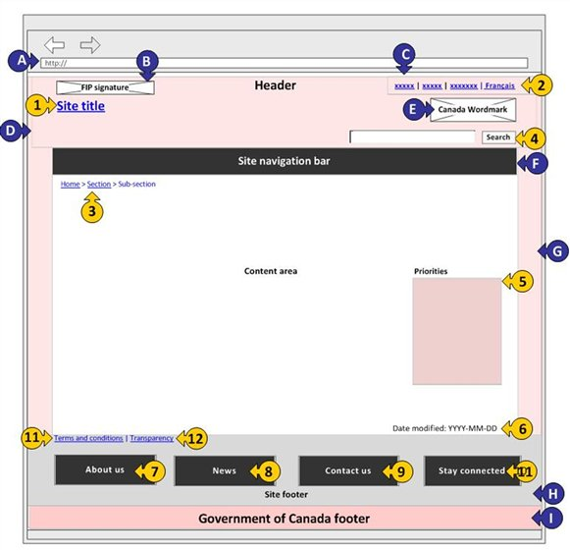
Design Your Site
Sketch out each page
Choose your template

Slide 32
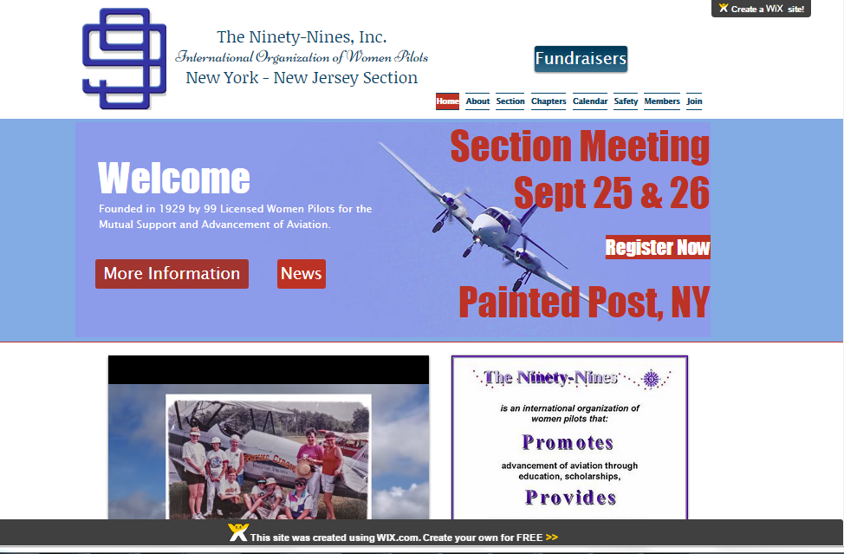
Keep in mind
Free sites
Web address may include Wix.com
Pages will have advertising from the builder such as Wix.com you might want to design around it

Slide 33
Shop for templates
Make sure the template fits in mood and message
Remember you can edit
Just because there are 27 buttons you don’t have to fill them up
When in doubt start from “scratch”

Slide 34
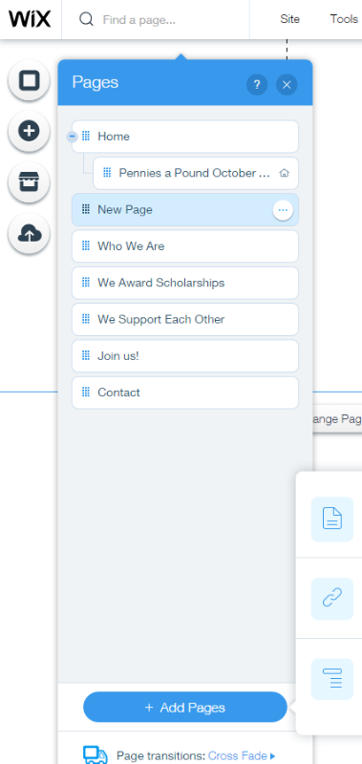
Add Pages Using your Navigation Topics

Slide 35
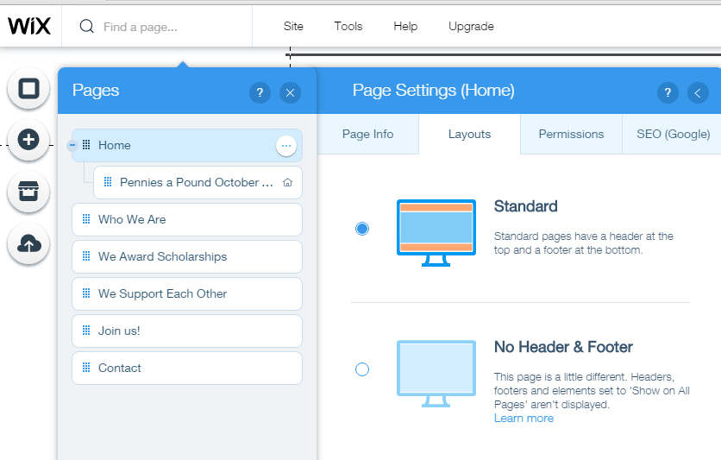
Set up Header and Footer
Header & Footers give boundaries
Provide consistent face forward about you
Always stay connected to your viewer
Keeps your nav buttons on every page
Provides visual continuity

Slide 36
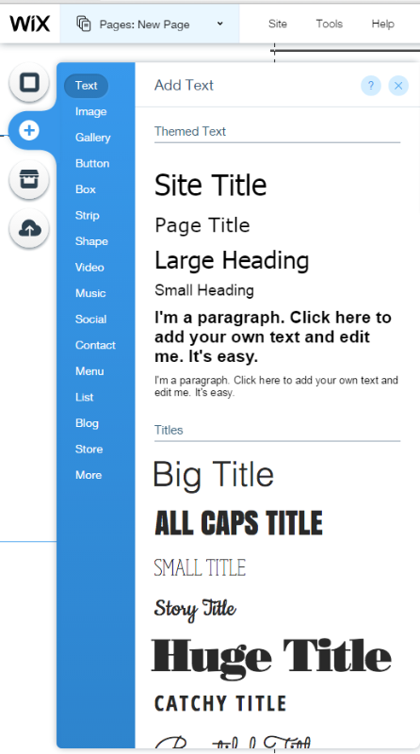
Pick Your Font
Keep it plain and consistent
Vary boldness and size
Avoid fussy fonts
Do not vary sizes too much

Slide 37
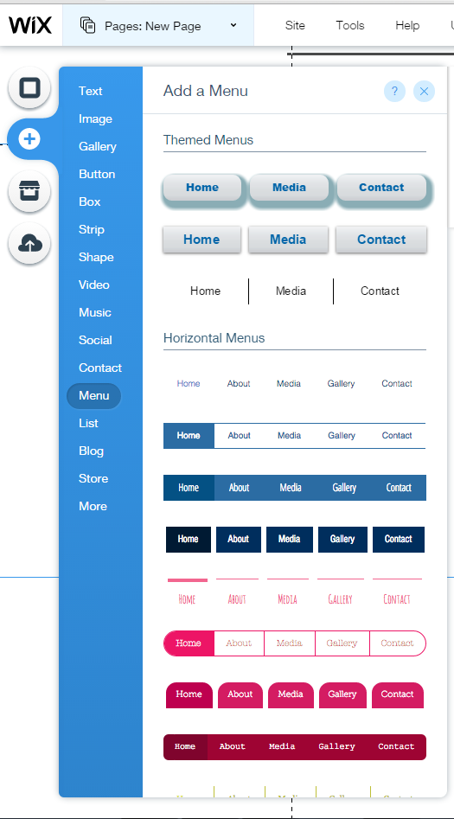
Pick your navigation bar and design around it

Slide 38
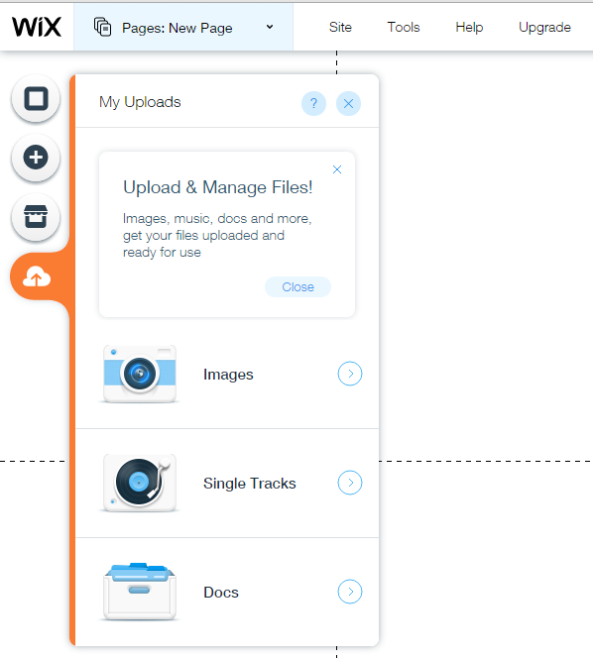
Upload all photos and files you may need
If you want a photo gallery – place the photos in a separate folder
Upload docs but link to the document from a graphic

Slide 39
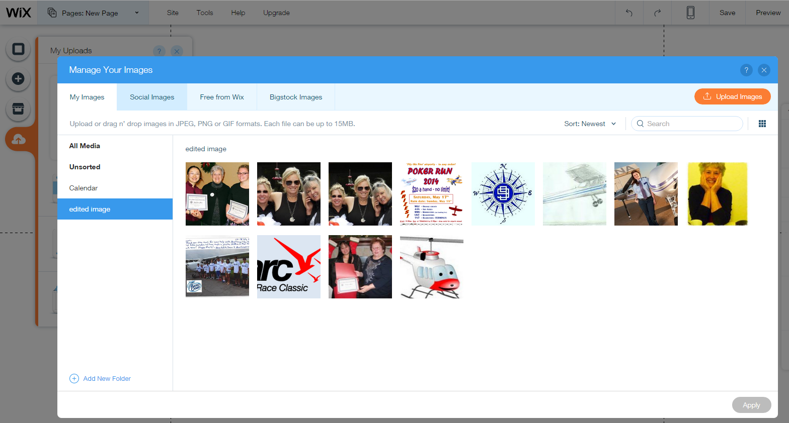
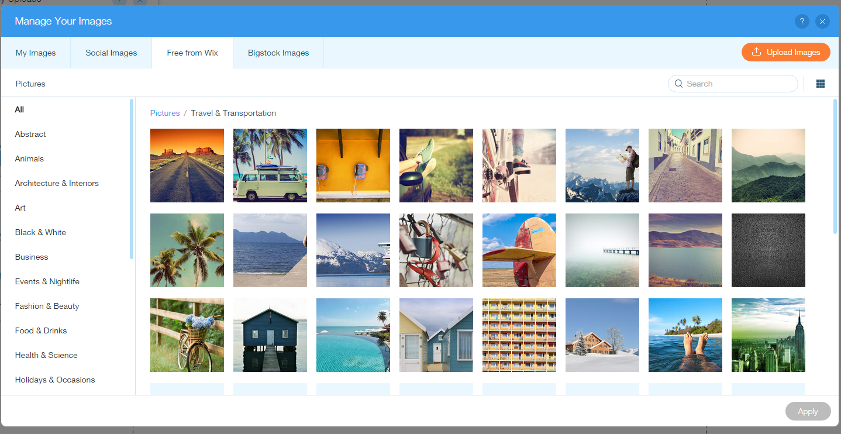
Upload all photos and re- title if needed – note free photos

Slide 40
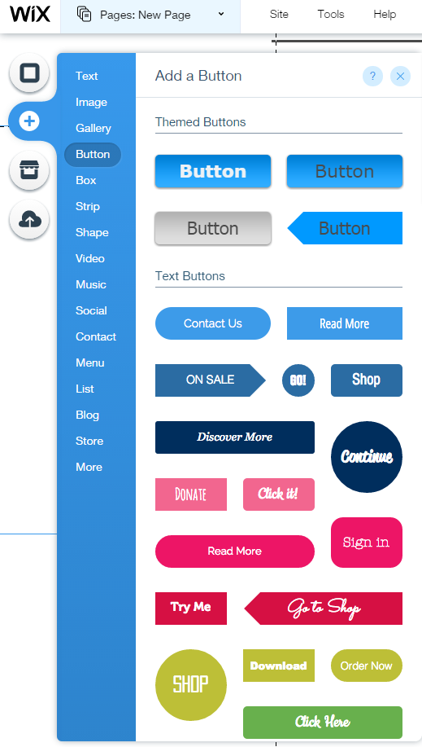
Use “+”to add interesting elements
Gallery - Slide show
Videos
Items to sell?
Add a Store
Donation page

Slide 41
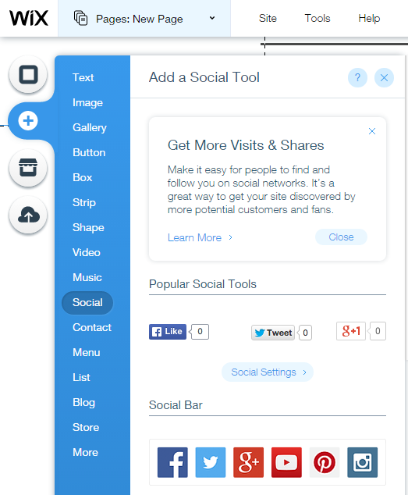
Use “+”to add links to facebook

Slide 42
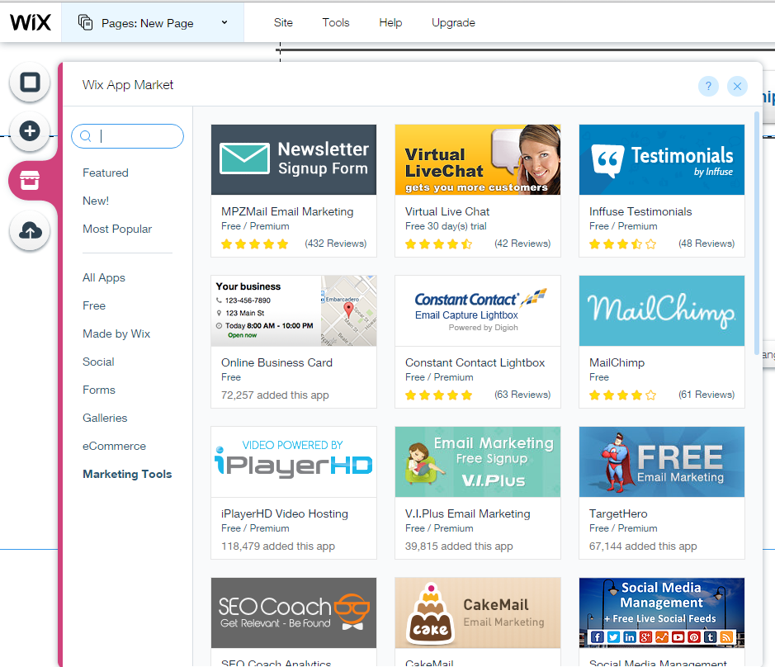
Avoid Add-ons
Save these for when you have more experience
They are enticing but can be very difficult to work with

Slide 43
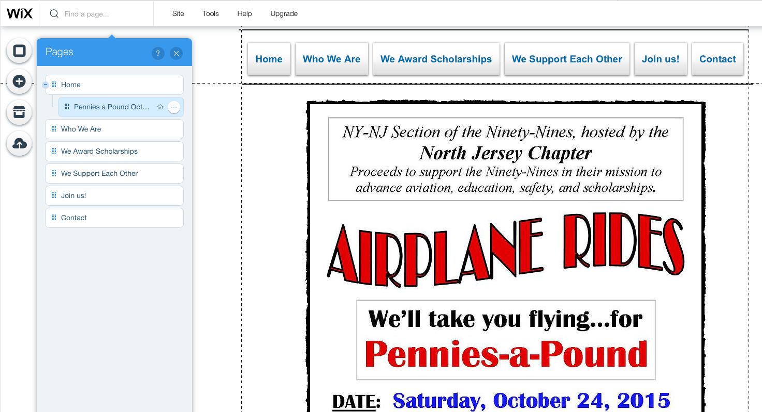
Consider a Leading Page
For special events make subpage of your home page

Slide 44
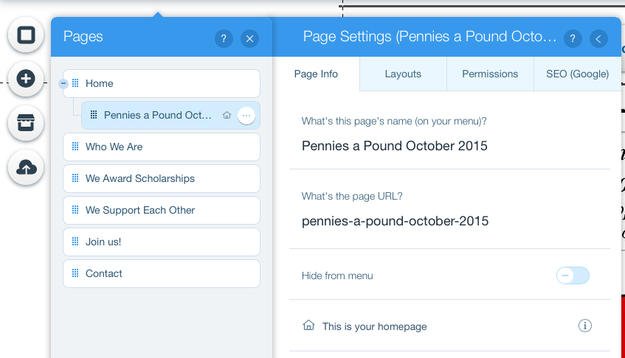
Leading Page
Your home page remains unchanged but your event will appear first
Make Pennies a Pound a subpage of your Home Page
On the Page Settings menus
Click “make this your home page”
Your home page will still be available

Slide 45
For Best Results
No blank pages
No blank links
No dead links
Include your state on header info
Link addresses to people
Make sure people have enough info on public meetings including location, whether visitors are welcomed and contact information
If you have items to sell, make sure you can buy online, set up a store & have contact info for queries
Check your work on several different computers, it may look different
Macs, PCs, iPads, Mobile devices (requires additional setup)
Have a stranger critique your page
Ask a student pilot if the site makes them want to join & why

Slide 46
Need some help?
Shannon OsborneSR@aol.com
Susan SylphenSky@Yahoo.com

Slide 47
Websites
http://www.nj99s.org
http://epa99s.org
http://www.alabama99s.org
http://www.womenpilotsnewengland.org/contact-us.html
http://womenpilotsene.org/new_eng_aviation%20sites.htm
http://sciotovalley99s.org

